Slide 1
Code Sample and Github Link

Slide 2
GitHub Link
Here is the github link of the project
https://github.com/csproject1/csproject1

Slide 3
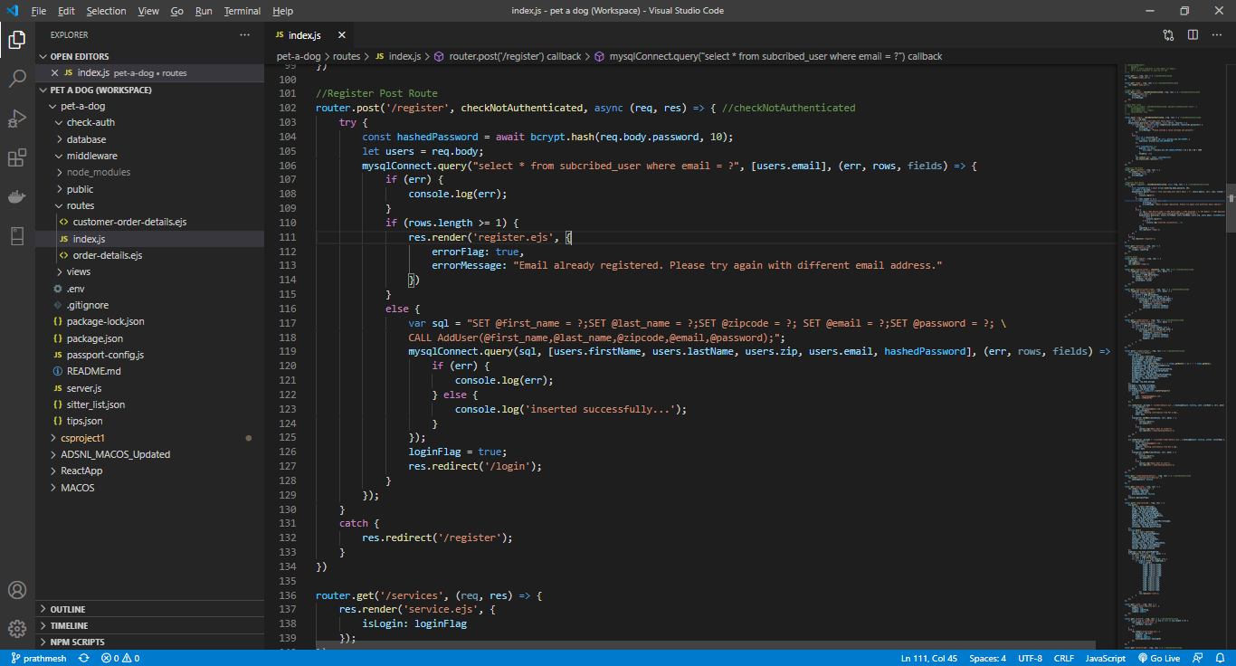
Github code screenshot and code samples

Slide 4
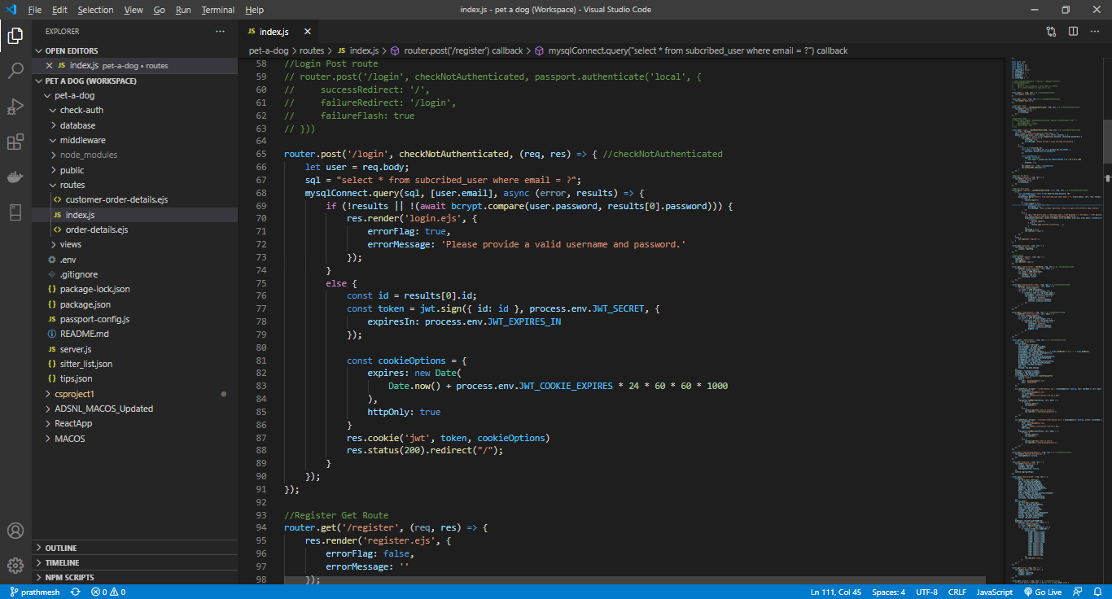

Slide 5
